Slide 1
Historical Unemployment in the United States
DATA 205 Capstone Project
Montgomery College: Rockville Campus
Ria Rhodes

Slide 2
Why This Matters:
Unemployment defines economic standings, regional inequality, demographic patterns, migration patterns, etc.
Historical changes in unemployment define periods of expansion/recession

Slide 3

Tools Used:
R Studio
ggplot2
dplyr
sf
USABoundaries
leaflet
scales
tidyverse
janitor

Slide 4
Goals:
Identify historical points of change in unemployment rate
Analyze and determine if geographic location in the US effects unemployment rate

Slide 5
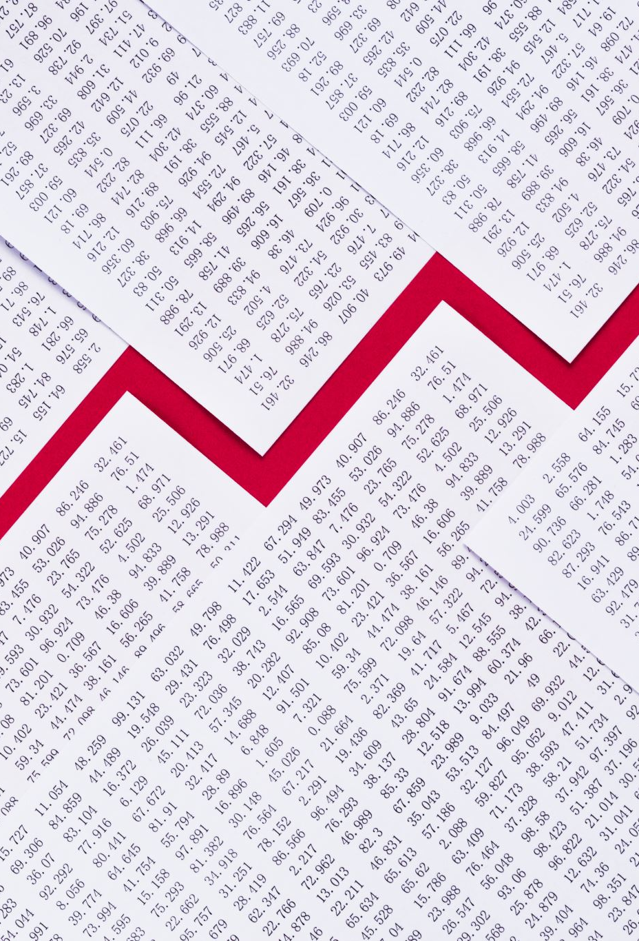
Data Sources:
U.S. Bureau of Labor Statistics: Local Area Unemployment Statistics
Reformatted variable names (Hyphens, empty spaces, snake case, lowercase, etc.)
Added a state name variable
Added a month variable
Added a state average percent change variable
U.S. Census Bureau Population Data
Reformatted variable names (Lowercase, remove “X” from variable names)
Reformat data (Long instead of tall)
Create population density variable

Slide 6
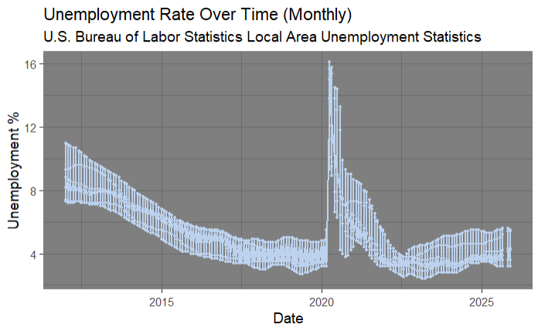
General EDA:

Slide 7
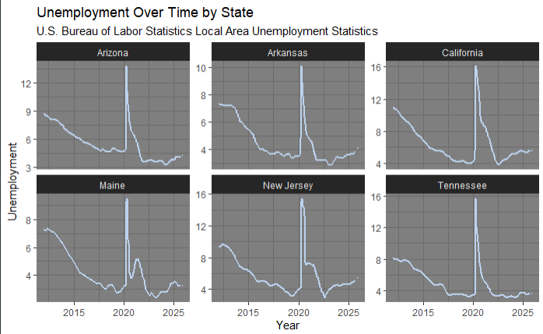
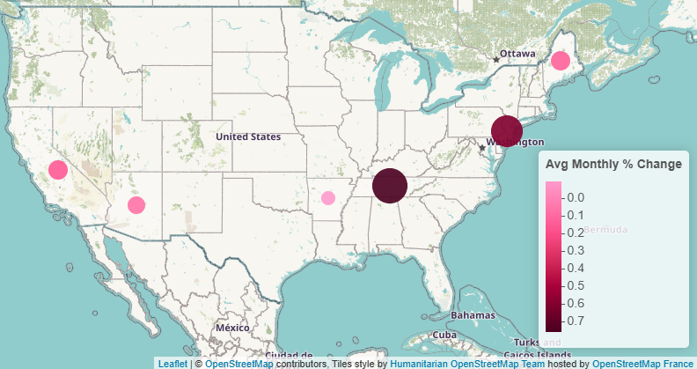
General EDA / GIS Graph:

Slide 8
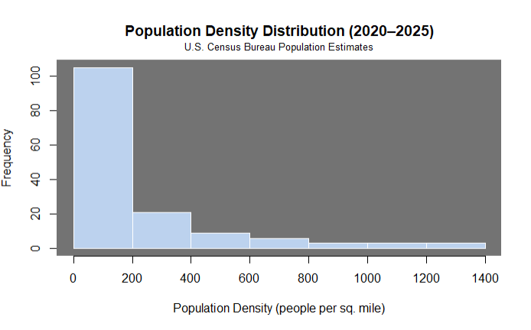
Statistical Analysis:
Pearson Correlation Test for ALL STATES (Population density, unemployment)
p = 0.22
Correlation coefficient = 0.10
Retest Pearson, logarithmically transformed
p = 7.127e-11 (Near zero!)
Correlation coefficient = 0.50

Slide 9
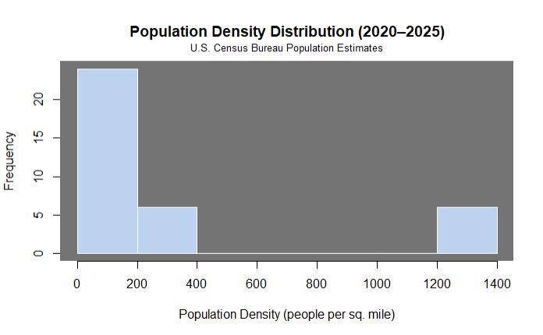
Statistical Analysis:
Pearson Correlation Test for MY STATES (Population density, unemployment)
p = 0.0946
Correlation coefficient = 0.2828599
Typically, lower density = higher unemployment (CA exception)
Retest Pearson, logarithmically transformed
p = 0.02295
Correlation coefficient = 0.3781806

Slide 10
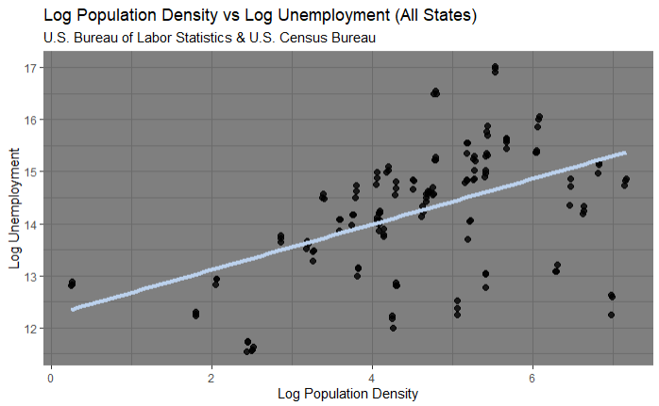
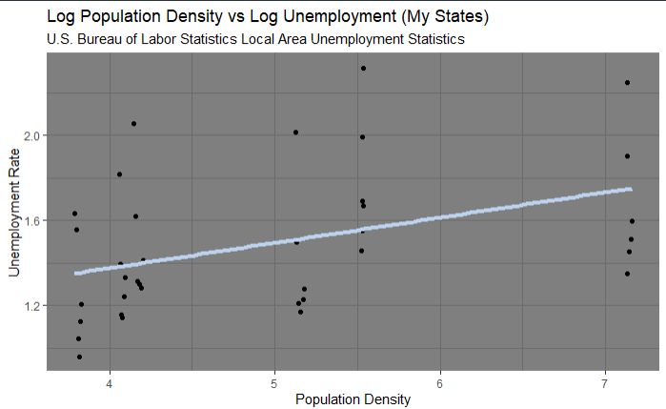
Statistical Analysis:

Slide 11
Conclusion / Key Findings:
COVID-19 spike and recovery (2020 – 2023)
Great Recession recovery (2012 – 2018)
“Full employment” plateau (2018 – 2020)
Effect of urbanization and work climate on geographic unemployment
California outlier
Different labor forces / work industries
Recovery speeds
Different degrees of population density

Slide 12
Reflection:
Challenging
Cleaning and merging data
Needing to filter to specific time frames
Rewarding
Noticing the patterns I expected
Having my research align with my data analysis
Future Changes
Integrate demographic information
Add more states for deeper and more specific analysis

Slide 13
Next Steps:
Compute a forecasting model to predict future unemployment rates
1
Investigate the degree of unemployment each state faces
2
Analyze the southern states to understand why some states are high in unemployment and some are low
3

Slide 14
Thank you to:
Professor Alraee, Professor Park, Professor Perine
Montgomery County Government
Data Montgomery
Class of ’26 Early College Data Science Cohort
DATA 205 Classmates

Slide 15
Questions / Comments / Concerns?
Sources:
USAFacts.org
AmericanCommunities.org
CNN U.S. Jobs Report
Investopedia.com
U.S. Bureau of Labor Statistics: Unemployment data
U.S. Census Bureau: Population data

